Slide 1
Amniotic Fluid Abnormalitis
By Dr shabani
Shahid Beheshti university of medical sciences
perinatologist

Slide 2
INTRODUCTION
AF is the liquid that surrounds the fetus after the first few weeks of gestation
It helps to protect the fetus from trauma to the maternal abdomen
It cushions the umbilical cord from compression between the fetus and uterus
It has antibacterial properties that provide some protection from infection
It serves as a reservoir of fluid and nutrients for the fetus

Slide 3
WHEN TO ASSESS AF
Qualitative or semiquantitative assessment of AF is a standard component of every second- and third-trimester ultrasound examination, regardless of indication
Because it is an indicator of fetal health
Its assessment is useful for evaluation of pregnancies at risk for an adverse pregnancy outcome

Slide 4
Oligohydramnios
Oligohydramnios refers to AFV that is less than the min expected for GA
It is diagnosed by ultrasound examination, preferably based on an objective measurement AFI ≤5 cm or SDP <2 cm
but a subjective assessment of reduced AFV is also acceptable

Slide 5
ETIOLOGY
Maternal
Medical or obstetric conditions associated with uteroplacental insufficiency: preeclampsia, chronic hypertension, collagen vascular disease, nephropathy, thrombophilia
Medications :angiotensin converting enzyme inhibitors, NSAIDs, trastuzumab
Diabetes insipidus (rare cases have presented with oligohydramnios that improve upon maternal treatment with desmopressin)

Slide 6
Placental
Abruption
Twin to twin transfusion (ie, twin polyhydramnios-oligohydramnios sequence)
Placental thrombosis or infarction

Slide 7
Fetal
Chromosomal abnormalities
Congenital abnormalities, especially those associated with impaired urine production or excretion
Growth restriction
Demise
Postterm pregnancy
Ruptured fetal membranes
Infection
Idiopathic

Slide 8
fetal prognosis
Fetal prognosis depends on several factors:
particularly underlying cause, severity (reduced versus no amniotic fluid), GA
Because an adequate AF is critical to normal fetal movement and second-trimester lung development and for cushioning the fetus and umbilical cord from uterine compression
Oligohydramnios from any cause are at risk for pulmonary hypoplasia (if second-trimester oligohydramnios), fetal deformation (if prolonged oligohydramnios), and umbilical cord compression.
Increased risk for fetal or neonatal death:
related to the underlying cause of the reduced AF, the sequalae of reduced AF, or both

Slide 9
Second trimester
By the beginning of the second trimester, fetal urine is being produced and entering the amniotic sac. Therefore, congenital anomalies related to the fetal kidney and urinary tract
Maternal and placental factors, as well as ROM (traumatic or spontaneous), are also common causes of oligohydramnios in 2 trimester
Fetal anomaly ,PPROM,Placental abruption , FGR, Idiopathic
The pregnancy outcome : generally poor due to fetal or neonatal death or pregnancy termination

Slide 10
Third trimester
Oligohydramnios first diagnosed in the third trimester is often PPROM
Other causes:
uteroplacental insufficiency (FGR, preeclampsia, and/or chronic abruption) & fetal anomalies
In addition, many cases are idiopathic
Fetal TORCH (toxoplasma gondii, rubella virus, cytomegalovirus, herpes simplex virus) and parvovirus B19 infections are uncommon but may be associated with second- or third-trimester oligohydramnios
Oligohydramnios is more prevalent in postterm pregnancies since AF normally begins to decline late in the third trimester

Slide 11
MANAGEMENT
Patients with newly diagnosed oligo early in 3 trimester undergo evaluation of possible causes and daily NSTs until fetal status is clarified
Patients with anhydramnios are hospitalized for both diagnostic evaluation & fetal surveillances
Maternal and FH and a targeted Ph.E to look for maternal and familial conditions that may be associated with oligo
Maternal medications that cause oligo affect fetal urination and do not cause FGR, whereas maternal medical disorders often result in uteroplacental insufficiency, leading to both FGR and oligo
Rule out PROM

Slide 12
Ultrasound
Assessment for fetal anomalies particularly assessment of :
Kidneys & Bladder
Umbilical cord fetal insertion site and vessel number
Fetal sex (males are prone to renal dysplasia and agenesis, PUV)
Second-trimester markers suggestive of aneuploidy
FGR
Placental abnormalities (eg, chronic abruption)
Doppler : There is no clear role for Doppler imaging in the evaluation of fetuses with kidneys and isolated oligohydramnios
presence of renal arteries when the kidneys are not well visualized

Slide 13
Genetic testing
If fetal anomalies are identified, offering fetal diagnostic genetic testing (amniocentesis for microarray on amniocytes) is routine.
For patients who decline amniocentesis, we offer a noninvasive screening test (cell-free DNA)

Slide 14
Diagnostic maternal hydration
–Oral hydration with one to two liters of water may be an alternative to amnioinfusion to transiently increase AFV for up to 48 hours, particularly in hypovolemic patients. This approach is easier and safer than intravenous (IV) fluid administration or amnioinfusion
maternal hydration was most effective in pregnancies with isolated oligohydramnios

Slide 15
Laboratory testing
No routine testing is required.
Testing maternal serum or AF for an infection-related etiology (maternal TORCH [toxoplasma gondii, rubella virus, cytomegalovirus, herpes simplex virus] and parvovirus 19 infection) depends on the degree of suspicion (eg, suggestive maternal Hx and symptoms, other fetal abnormalities on ultrasound)

Slide 16
Oligohydramnios after amniocentesis
An exception to the poor prognosis described above is oligohydramnios related to second-trimester amniocentesis. In these cases, the membranes often "reseal," amniotic fluid reaccumulates, and pregnancy outcome is normal

Slide 17
Timing of delivery
Oligohydramnios of known etiology :
The indications for delivery in pregnancies with oligohydramnios attributable to a specific condition : preeclampsia, PROM, FGR, congenital anomaly, postterm pregnancy
Idiopathic oligohydramnios (ACOG):
In pregnancies with idiopathic oligo and reassuring fetal testing we suggest delivery at 36 to 37+6 w
If diagnosed later If diagnosed later : at Dx

Slide 18
Intrapartum fetal monitoring
In patients with oligohydramnios, we recommend using continuous electronic fetal monitoring, given the increased risk for cord compression. However, most patients will have a normal tracing

Slide 19
Polyhydramnios
also known as hydramnios:
refers to an excessive volume of AF
It should be suspected clinically when uterine size is large for gestational age (fundal height [cm] : exceeds weeks of gestation by >3)
Dx: sonographic documentation of excessive AFV by a quantitative technique :AFI ≥24 cm or single deepest pocket (SDP) ≥8 cm

Slide 20
Conditions associated with polyhydramnios
Genetic syndromes:
Trisomy 18 or 21,Prader-Willi,Bartter,Beckwith-WiedemannRASopathy (eg, Noonan syndrome, cardiofaciocutaneous syndrome, Costello syndrome, capillary malformation-arteriovenous malformation, and neurofibromatosis type 1)
Fetal neuromuscular disorder that impedes swallowing (eg, myotonic dystrophy, anencephaly)

Slide 21
Conditions associated with polyhydramnios
Fetal anomalies : Fetal anomalies account for approximately one-third of singleton pregnancies with polyhydramnios
The most common anomalies interfere with fetal swallowing and/or absorption of fluid
Fetal structural anomaly that impedes swallowing:
Primary gastrointestinal obstruction (eg, esophageal or duodenal atresia)
Secondary gastrointestinal obstruction (eg, congenital diaphragmatic hernia, cervical or thoracic mass)
Craniofacial abnormality (eg, cleft lip/palate, facial tumor [eg, oropharyngeal teratoma], micrognathia)

Slide 22
Conditions associated with polyhydramnios
High fetal cardiac output state:
Supraventricular tachycardia
Severe anemia (eg, alloimmunization, viral infection [Parvovirus B19, cytomegalovirus], hemoglobinopathy)
Fetal or placental mass with arteriovenous shunt (eg, sacrococcygeal teratoma, large chorioangioma)
Twin-twin transfusion syndrome
Maternal DM, Macrosomia, Hydrops fetalis
Idiopathic cases : Approximately 40 percent of polyhydramnios is idiopathic

Slide 23
Fetal growth restriction : When combined with polyhydramnios, FGR is associated with high morbidity and mortality
The combination of fetal growth restriction and polyhydramnios is suggestive of trisomy 18
Neuromuscular disorders : Fetal neuromuscular disorders, such as anencephaly and myotonic dystrophy, are rare and generally cause polyhydramnios by interfering with swallowing

Slide 24
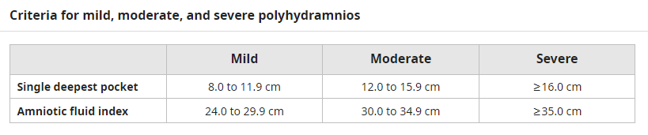

Slide 25
POSTDIAGNOSTIC EVALUATION
Detailed medical Hx:
to evaluate for heritable diseases associated with polyhydramnios.:arthrogryposis often presents in the second trimester with polyhydramnios and multiple congenital contractures, in ultrasound
personal/family history suggests a hereditary anemia (eg, alpha-thalassemia)

Slide 26
Evaluate for fetal hydrops :
If polyhydramnios is accompanied by hydrops, :Fetal anemia is a common cause of hydrops and has both immune and nonimmune etiologies
Measure MCA PSV: In the initial evaluation of all cases of idiopathic poly before 35 w, even in the absence of hydrops
Evaluate for fetal anomalies :A detailed sonographic evaluation for fetal anomalies
Offer genetic counseling and fetal genetic studies: genetic counseling and offering amniocentesis for fetal microarray in pregnancies with a congenital anomaly or severe polyhydramnios
Screen for maternal diabetes

Slide 27
OUTCOME
Many idiopathic cases resolve spontaneously, especially if mild. Transient cases generally have a benign maternal course, but associated with an increased risk for macrosomia
Maternal respiratory compromise
PROM
Preterm labor and birth
Fetal malposition
Macrosomia (potentially leading to shoulder dystocia)
Umbilical cord prolapse
Abruption (particularly upon membrane rupture)
Longer second stage of labor
Postpartum uterine atony

Slide 28
Management
Idiopathic polyhydramnios :
Depends upon the GA, severity, and presence of symptoms
Mild to moderate poly:BPP, NST every 1 to 2 w until 37 w, and then weekly from 37 w to birth
severe : BPPs (including NST) every week from Dx until birth
In interpreting the BPP score, clinicians should be cautious about conclusions of fetal well-being with a borderline score (6/8) since the two points for amniotic fluid volume (AFV) in these cases are not reassuring

Slide 29
MANAGEMENT
Amnioreduction :severe shortness of breath or abdominal discomfort and uterine contractions, we give a short course (48 h) of indomethacin
Indomethacin : SMFM recommends not indomethacin for the sole indication of reducing amniotic fluid
In pregnancies <32 w with preterm labor/uterine irritability, we sometimes use a short course (48 h) of indomethacin for its combined effects of tocolysis and reduction in AF

Slide 30
Timing of delivery
Mild to moderate poly : In patients with mild to moderate idiopathic polyhydramnios and normal BPPs
Induce labor at 39 to 40 as the risk of fetal death appears to increase significantly at term

Slide 31
Timing of delivery
Severe idiopathic poly: Induction of labor at 37 w to minimize the risk of umbilical cord prolapse and/or abruption in spontaneous PROM
Earlier delivery on a case-by-case basis to patients between 34 and 37 w if symptoms are intolerable and not respond to amnioreduction
Delivery at tertiary center in severe idiopathic poly since clinically important fetal abnormalities may not identified prenatally

Slide 32
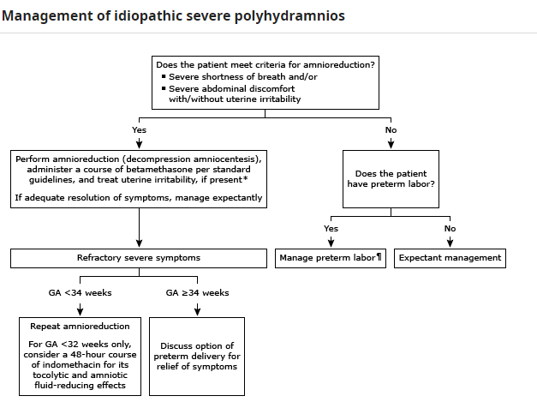

Slide 33
Thanks for Attention

